Slide 1
Team No. 20
IMAGE BASED GARBAGE CLASSIFICATION USING TRANSFER LEARNING
Presentation By,
D.Lakshmi Sailaja(23BTRCL038)
V.Dharnish(23BTRCL040)
C.V.Pranavi(23BTRCL175)
A.Harshavardhan(23BTRCL247)
Guided By,
Dr. Sankar
Assistant Professor / CSE-AIML

Slide 2
CONTENTS
Abstract
Introduction
System requirement
Literature Survey
Existing system
Block diagram
Proposed System
Conclusion
References

Slide 3
ABSTRACT
One of the biggest issues facing society and the environment today is the growing amount of municipal solid waste. To improve recycling effectiveness and less environmental pollution, effective waste segregation is crucial.
To classify waste images into various categories, including plastic, paper, metal, glass, cardboard, and organic waste, pre-trained convolutional neural network (CNN) models are modified and refined.
Convolutional Neural Networks (CNNs) and transfer learning techniques are used in this paper to propose an automated garbage classification system based on images. To classify waste objects and organic waste, pre-trained deep learning models—such as VGG16 and ResNet50—are used as feature extractors and refined.
Transfer learning reduces training time and computational requirements while increasing classification accuracy by utilizing knowledge gained from large-scale image datasets.

Slide 4
INTRODUCTION
Rapid Increase in Waste Generation, Urbanization, population growth, and rising consumer demand have significantly increased solid waste production, leading to environmental pollution and public health risks.
Need for Automated Waste Segregation Traditional manual waste sorting methods are slow, inconsistent, and error-prone, highlighting the need for efficient automated waste classification systems.
Role of CNN in Waste Classification Convolutional Neural Networks (CNNs) effectively classify waste images by automatically learning hierarchical visual features such as edges, textures, and object shapes.
Transfer learning leverages pre-trained deep learning models to reduce computational cost, training time, and dataset requirements while maintaining high classification accuracy.
The study fine-tunes VGG16 and ResNet50 architectures with additional fully connected layers and a softmax classifier to develop an accurate, reliable, and computationally efficient garbage classification system for smart waste management applications.

Slide 5
SYSTEM REQUIREMENT
Programming Language: Python 3.8+
Deep Learning Framework: TensorFlow / Keras
Pre-trained CNN Models:
ResNet50
VGG16
Libraries: NumPy, OpenCV, Matplotlib, Scikit-learn
Techniques Used: Transfer Learning & Fine-Tuning
Input Image Size: 224 × 224 pixels
Optimizer: Adam

Slide 6
LITERATURE SURVEY
Deep Learning for Waste Classification :
Several studies have shown that Convolutional Neural Networks (CNNs) achieve high accuracy in image- based waste classification by automatically extracting visual features such as shape, texture, and color.
Application of Transfer Learning :
Researchers have successfully applied transfer learning using pre-trained models to reduce training time and improve performance, especially when datasets are limited.
VGG16 in Image Classification :
VGG16 has been widely used due to its simple and uniform architecture, providing strong feature extraction capabilities for object recognition tasks, including waste sorting.
ResNet50 and Residual Learning :
ResNet50 addresses the vanishing gradient problem using residual connections, enabling deeper networks and improved classification accuracy in complex image datasets.
Smart Waste Management Systems :
Recent research integrates deep learning-based classification models into automated recycling systems and smart bins to enhance sustainable waste management practices.

Slide 7
EXISTING SYSTEM
The algorithms which we are using:
CNN with Transfer Learning :
The proposed system uses Convolutional Neural Networks (CNN) with pre-trained models like ResNet50 and VGG16. Transfer learning and fine-tuning improve classification accuracy and reduce training time.
ResNet50 :
ResNet50 is a deep CNN architecture that uses residual connections to solve the vanishing gradient problem. It enables training of very deep networks and provides high accuracy in image classification tasks.

Slide 8
VGG16 :
VGG16 is a 16-layer deep convolutional neural network known for its simple and uniform architecture. It is widely used for image classification and transfer learning applications.
Fine-Tuning :
Fine-tuning is a transfer learning technique where the higher layers of a pre-trained model are retrained on a new dataset. It improves model performance by adapting general features to domain-specific tasks like garbage classification.

Slide 9
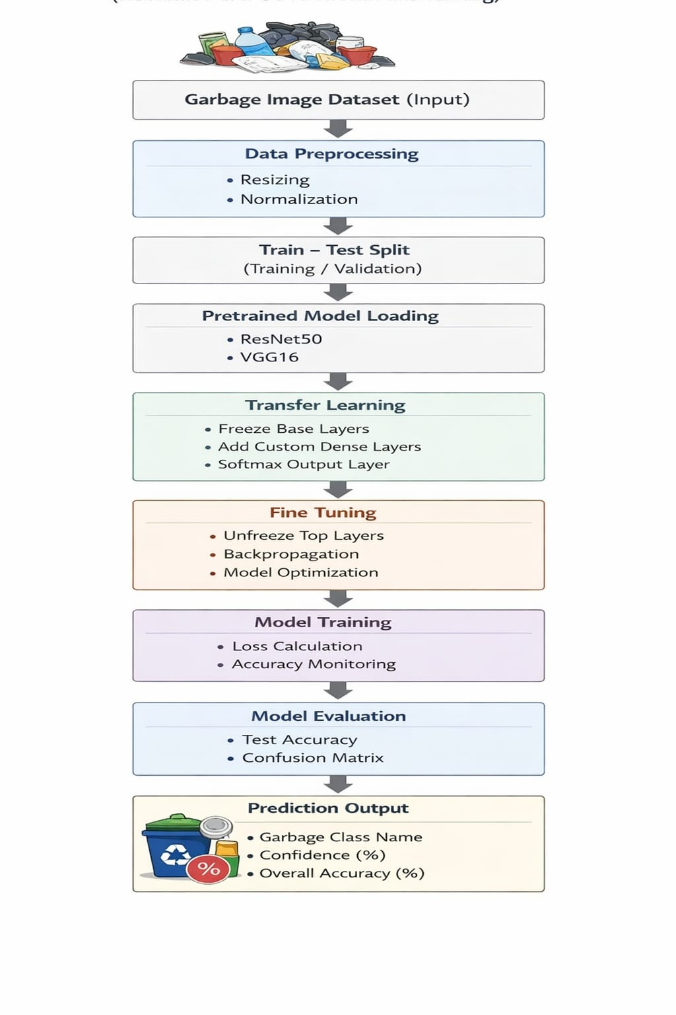
BLOCK DIAGRAM

Slide 10
PROPOSED SYSTEM
Garbage Image Dataset (Input):
The system takes a labeled garbage image dataset.Images belong to categories like paper, plastic, metal, glass, etc.This dataset is used to train and test the model.
Data Preprocessing :
Resizing - Image resizing is the process of converting all input images into a fixed and uniform size before feeding them into a convolutional neural network (CNN). Every input image must be resized to this dimension to ensure compatibility. All images are resized (224×224) to match model inputsize.
Normalization – It is the process of scaling pixel intensity values to a smaller and standardized range before training the model. Pixel values are scaled (0–1 range) for better learning. Large input values can slow down learning and make gradient updates unstable.

Slide 11
Train–Test Split :
The dataset is divided into -Training set → Used to train the model, Validation or Test set → Used to evaluate performance.
The model learns features, patterns, and relationships from this data.
Usually consists of 70%–80% of the total dataset.
Pretrained CNN models are loaded:
ResNet50, VGG16These models are already trained on large datasets (like ImageNet).They provide powerful feature extraction capability.
Transfer Learning:
Base layers of the pretrained model are frozen.
Custom layers are added - Dense layersDropout layer (optional)Softmax output layer (for multi-class classification)The model learns garbage-specific features.

Slide 12
Fine-Tuning:
Top layers of the pretrained model are unfrozen. Backpropagation updates selected layers. Improves model performance and accuracy, Enhances feature specialization, Reduces overfitting, Achieves better generalization, Requires less computational power than training from scratch
Model Training:
The model is trained using - Loss function (Categorical Crossentropy), Optimizer, Accuracy and loss are monitored during training.
Pre-trained models extract features.
Custom classification layers learn garbage-specific patterns.
Training adjusts weights to improve classification accuracy.
Model Evaluation:
Model is tested using validation, test data.
Performance metrics - Test AccuracyConfusion, MatrixPrecision, Recall and F1score.
Prediction Output:
When a new garbage image is given the system predicts Garbage Class NameConfidence Percentage (92.4%) Overall Model Accuracy (95%).

Slide 13
CONCLUSION
The proposed Image-Based Garbage Classification system effectively utilizes Convolutional Neural Networks (CNN) combined with transfer learning to automate the waste segregation process. By employing pre-trained models such as ResNet50 and VGG16, the system successfully extracts deep and meaningful visual features from garbage images, achieving high classification accuracy. The application of fine-tuning enables the model to adapt to waste-specific patterns, enhancing performance while reducing overall training time and computational complexity. Additionally, preprocessing and data augmentation techniques improve generalization capability and minimize overfitting. In conclusion, the proposed software-based approach proves that transfer learning is a reliable, efficient, and scalable solution for intelligent waste classification systems, contributing to improved recycling efficiency and sustainable waste management practices.

Slide 14
REFERENCES
https://doi.org/10.3390/su17198761
http://creativecommons.org/licenses/by-nc/4.0/)
Intelligent Waste Classification System Using Deep Learning Convolutional Neural Network . (SMPM) 2019 , 10.1016/j.promfg.2019.05.086.
Classification of Waste Materials using CNN Based on Transfer Learning . fire ’22: forum for information retrieval evaluation ; https://dl.acm.org.com
Garbage In, Insights Out: Deep Transfer Learning for Automatic Solid Waste Classification “.2024 IEEE 1st International Conference on Green Industrial Electronics and Sustainable Technologies (GIEST).

Slide 15
THANK YOU

